Slide 1
C2T2 - Classifier RESULTS
SERGIO ROBLEDO

Slide 2
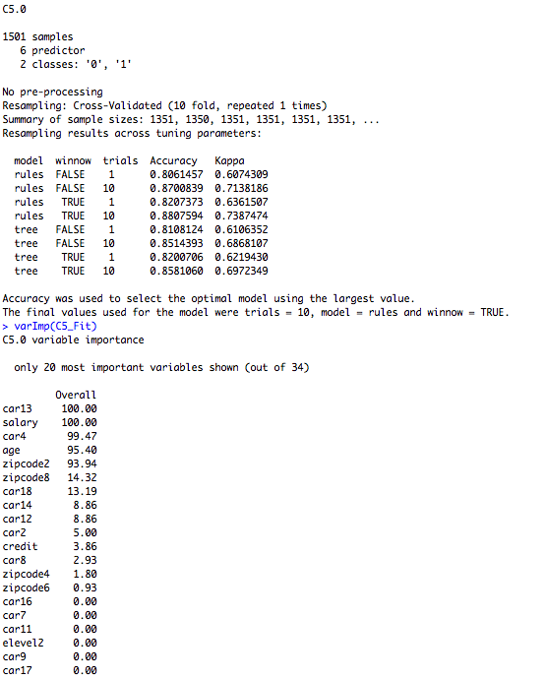
C5.0 DT CLASSIFIER RESULTS
Parameters Tested
  10-fold Cross Validation
  Automatic Tuning Grid
    tuneLength = 2
Best Accuracy and Kappa Values from 10 Trials, Model: Rules & Winnow: True
  Accuracy: 0.8807594
  Kappa: 0.7387474
Important Variables
  Mazda: 100
  Salary: 100
  Chevrolet: 99.47
  Age: 95.40
  East North Central: 93.94

Slide 3
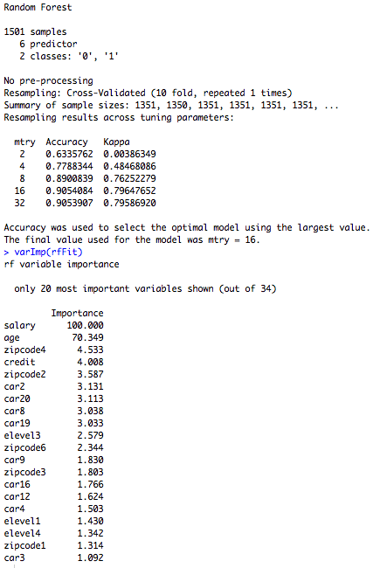
RANDOM FOREST CLASSIFIER RESULTS
mtry Values Used
  2, 4, 8, 16, 32
mtry = 16 gave me the best accuracy and kappa values for the Random Forest
  Accuracy: 0.9053907
  Kappa: 0.79647652
The two main variables shown to impact the Random Forest Brand Prediction are Salary & Age
  Salary Importance = 100
  Age Importance = 70.349

Slide 4
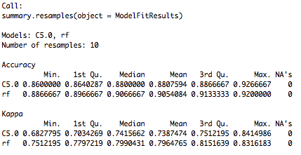
MODEL RESULT COMPARISON SUMMARY
The C5.0 had the highest maximum values for both accuracy and kappa.
However, the Random Forest model constantly outperformed the C5 model on average.
  Therefore, I chose the Random Forest

